Slide 1
CS 0007: Introduction to Java
Lecture 9
Nathan Ong
University of Pittsburgh
September 29, 2016

Slide 2
If Statements
English usage?
“If it will rain today, then I will bring my umbrella.”
Rain today would indicate that I have brought my umbrella
Cause and effect relationship: when a condition is met, a behavior is elicited.

Slide 3
Skeleton Statement
if(<boolean condition>)
{
…
}
…

Slide 4
Boolean Condition
Must evaluate to true in order for the statements within the if-block to execute.
Evaluating to false will skip the block.

Slide 5
Java Example
/* checkWeather returns true if it
* will rain today.*/
boolean rainToday = checkWeather();
if(rainToday)
{
bringUmbrella();
}
goToSchool();

Slide 6
if()
if hasFacebook is true, then print "has a Facebook"
if(hasFacebook)
{
System.out.println("has a Facebook");
}//end block if(hasFacebook == true)
But how do I represent when hasFacebook is false?

Slide 7
else if()
Otherwise, if hasFacebook is false, then print "does not have a Facebook"
else if(!hasFacebook)
{
System.out.println("does not have a Facebook");
}//end block else if(hasFacebook
// == false)

Slide 8
if()
if(hasFacebook)
{
System.out.println("has a Facebook");
}//end block if(hasFacebook)
else if(!hasFacebook)
{
System.out.println("does not have a Facebook");
}//end block else if(!hasFacebook)
Still kinda wordy…

Slide 9
else if(!hasFacebook)
How many values can hasFacebook have?
How many values can a boolean have?
Why do we even need to check for !hasFacebook when we know if it is not true, it should do that portion of code?
→ else

Slide 10
else
When all else fails, execute everything inside this block.
All boolean expressions from the previous if and else if blocks must all evaluate to false for this block to execute.
In the hasFacebook example, because we know it can only hold two values, if it is not true, then it must be false.

Slide 11
else
if(hasFacebook)
{
System.out.println("has a Facebook");
}//end block if(hasFacebook)
else
{
System.out.println("does not have a Facebook");
}//end block else
STILL kinda wordy…

Slide 12
System.out.println("has a Facebook");
Both lines use "a Facebook"
How can we use this to our advantage?
Why do we even want to do this?

Slide 13
Optimization
Eventually, we get down all of that code into something very short
Shorter code generally (in all the programming you will be doing) means a faster program and is easier to read
if statements take time to evaluate
If you had five million of them, your program would be painfully slow. Reduce the number of if statements, if you can.

Slide 14
Reducing Common Code
if(hasFacebook)
{
System.out.print("has");
}//end block if(hasFacebook)
else
{
System.out.print("does not have");
}//end block else
System.out.println(" a Facebook");
This is overkill for this example, but may prove useful in later situations. I can still make this even shorter.

Slide 15
?:
Simple choice operator
(boolean expression) ? true return : false return;
Only use this in very simple if cases

Slide 16
?:
(hasFacebook ? "has" : "does not have") + " a Facebook");
Now we can get it all in one line!

Slide 17
Adding It in
public class Name
{
public static void main(String[] args)
{
String firstName = "Nathan";
char midInitial = 'R';
String lastName = "Ong";
int age = 19;
boolean hasFacebook = true;
System.out.println(firstName + " " + midInitial + " " + lastName + ", age: " + age + ", " + (hasFacebook ? "has" : "does not have") +
" a Facebook");
}//end method main
}//End class Name
What is the output?

Slide 18
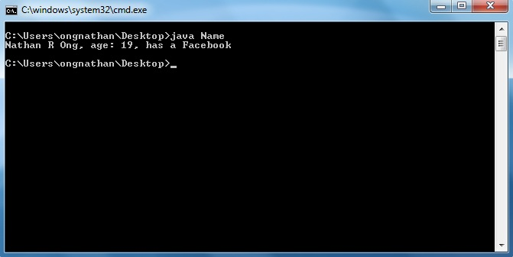
Was it really worth it?
How messy was that code?

Slide 19
Trade-Offs
Readability vs. Length
Who even wants to read a four-line one-liner?
Instead you should somehow tell the programmer what you mean (also so you don't forget)
Remember the strange green thing at the end?

Slide 20
Comment Reminders
public class Name
{
public static void main(String[] args)
{
String firstName = "Nathan";
char midInitial = 'R';
String lastName = "Ong";
int age = 19;
boolean hasFacebook = true;
System.out.println(firstName + " " + midInitial + " " + lastName + ", age: " + age + ", " + (hasFacebook ? "has" : "does not have") +
" a Facebook");
}//end method main
}//End class Name

Slide 21
if() recap
//always run this code
if(condition1 is true)
{
//run this code
}
else if(condition2 is true)
{
//run this code
}
else if(condition3 is true)
{
…
}
…
else //if conditions 1…n were not satisfied
{
//run this code
}
//always run this code

Slide 22
Revisiting Scope
Scope works by curly brackets.
Curly brackets surround all newly declared information, keeping it hidden from code outside of the curly brackets.

Slide 23
Scope
Confidential
Secret
Top Secret

Slide 24
Scope
public class ScopeExample
public static void main
public static void func
if
if
if
else if
Darker shades can see lighter shades, but not vice versa

Slide 25
Scope in Code
public class Name
{
public static void main(String[] args)
{
int x = 0;
//x == 0, y is undefined
if(x == 0)
{
int y = 10;
x = 15;
//x == 15, y == 10
}
//x == 15, y is undefined
}//end method main
}//End class Name

